Slide 1
RAID종류 및 SYNC관련 조사
김서진

Slide 2
Hardware RAID
장점
Boosts system performance for backups and restoration, (especially in legacy equipment with limited processing power, by adding DRAM cache memory to the system.) Translates to less strain on the system when writing backups, and less downtime when restoring data.
Adds RAID configuration options that may otherwise be unavailable using just the motherboard—like RAID 5/6, for example, which provides one and two drive failure tolerance.
Protection against data corruption resulting from a loss of power during the backup process. Battery backup units (BBU) or onboard Flash memory in RAID cards provide the extra fail-safes here.
Adds system compatibility with enterprise SAS HDDs, which are designed for 24/7 operation and have extra error correcting features compared to consumer-grade SATA III HDDs.

Slide 3
Software RAID
장점
Software RAID doesn’t needs high cost for additional infra.
Modern multi-core server CPUs are powerful enough to handle backup and restoration without a lot of system strain. Gains in backup and restore performance may be unnoticeable if an additional hardware RAID card is added to the system.
Software RAID is used exclusively in large systems (mainframes, Solaris RISC, Itanium, SAN systems) found in enterprise computing.
SMBs using NAS devices for backup and restore purposes will find many software-RAID based options: Netgear ReadyNAS; Synology DiskStation (DS), Buffalo TeraStation, are examples.
Not all software RAID is equal. Flexibility is the key advantage of an open source software RAID, like Linux mdadm.

Slide 4
HW RAID 및 SW RAID 비교
Hardware RAID
장점: High performance and ensure consistency for backup and recovery
more common in Windows Server environments
단점: High cost for non-volatile RAM or battery-backed DRAM
Software RAID
장점: more prevalent in open source server systems, wherein its flexibility and comparative low cost of entry make it an attractive option.
단점: filesystem consistency for power failure.
answering the hardware RAID vs Software RAID question depends on assessing the IT infrastructure—the sever hardware and system administrators operating it

Slide 5
Sync issue
1. R-Barrier: Rapid Barrier for Software RAID Cache Using Hints from Journaling Filesystem[ICPADS’12]
2.Barrier 동작 메커니즘(request reordering, force to flush)
출처: https://www.mjmwired.net/kernel/Documentation/block/barrier.txt
3. Journal-guided Resynchronization for software RAID[FAST’05]
4. RAID5의 성능 향상을 위한 부하 균등 destage 기법[KCC’98]
5. RAID – TEXT BOOK
출처: http://pages.cs.wisc.edu/~remzi/OSTEP/file-raid.pdf

Slide 6
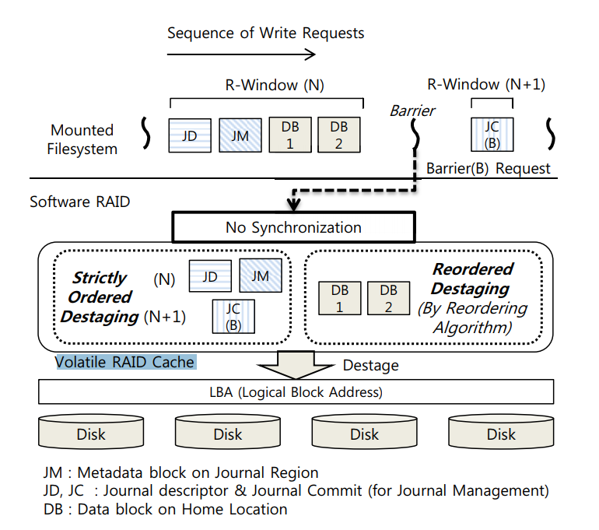
R- BARRIER 내용
I/O Barrier: Volatile RAID Cache를 강제적으로 destage 하는 것.
the frequent cache synchronization of I/O Barrier nearly disables the write cache functionalities including the request reordering.

Slide 7
Forced flushing to physical medium
I/O barriers need to guarantee that requests actually get written to non-volatile medium in order.
No write-back cache.
Keeping requests ordered
Write-back cache but no flush operation.
There's no way to guarantee physical-medium commit order. This kind of devices can't to I/O barriers.
Write-back cache and flush operation but no FUA (forced unit access).
We need two cache flushes - before and after the barrier request.
Write-back cache, flush operation and FUA.
We still need one flush to make sure requests preceding a barrier are written to medium, but post-barrier flush can be avoided by using FUA write on the barrier itself.
Notes:
https://www.mjmwired.net/kernel/Documentation/block/barrier.txt

Slide 8
Journal-guided Resynchronization for software RAID
Software RAID Interface
The Linux implementation for the verify read request is rather straight-forward.
When the file system wishes to perform a verify read request, it marks the corresponding buffer head with a new RAID synchronize flag.
Upon receiving the request, the software RAID-5 layer identifies the flag and enables an existing synchronizing bit for the corresponding stripe. This bit is used to perform the existing resynchronization process.
Its presence causes a read of the entire stripe followed by a parity check, exactly the functionality required by the verify read request.

Slide 9
RAID5의 성능 향상을 위한 부하 균등 destage 기법
Controller 내에 디스크 캐쉬에 저장된 write reques를 반출 안고리즘에 따라서 디스크로 쓰여지며, 반출 알고리즘은 쓰기 캐쉬내의 data를 디스크로 스케줄하는 순서와 방법을 결정한다.
기존의 반출 알고리즘은 디스크 배열을 구성하는 디스크를 전체적으로 고려하는 것이 아니라, 개개의 디스크별로 최적의 반출 동작을 수행하도록 되어있으므로, 특정 디스크들에 부하가 불균등하게 부가될 수 있다.
각각의 반출 알고리즘에 따라서, read/write request가 어떻게 각각의 물리적 디스크로 스케줄될 건지를 결정한다.
RAID5에서는 하나의 I/O Request가 발생되면 여러 디스크로 입출력 요구가 분산되어 처리되기 때문에, 일부 디스크에서 부하가 증가하면 평균 대기 지연시간이 증가하므로, host 입장에서 처리 시간이 증가한다.

Slide 10
RAID text book
Before analyzing RAID-1, let us first discuss a problem that arises in any multi-disk RAID system, known as the consistent-update problem [DAA05]. The problem occurs on a write to any RAID that has to update multiple disks during a single logical operation.
Finally, you can even build RAID as a software layer: such software RAID systems are cheaper but have other problems, including the consistent-update problem [DAA05].
a/b/d/e

